Slide 1

Specialization: Supervised ML, Predictive Analytics, Customer Analytics | Business Focus: Telecommunication | Tools: Python
Data Science Project
Data Science Project
Predicting Customer Churn
Predicting Customer Churn Between Competitors in the Telecommunications Industry
Identifying Customers that are Susceptible to Churn in order to Enhance Retention Strategies and Boost Business Growth
Project Learning Objectives
The primary objective of this project is to develop a predictive model that can accurately forecast customer churn within the telecommunications industry. Specifically, the project aims to leverage historical customer data and relevant features to create a machine learning model capable of identifying customers who are likely to churn. The model's performance will be assessed using appropriate evaluation metrics.
Learning Skills
Python Proficiency
Data Preprocessing
Exploratory Data Analysis
Model Development
Churn Prediction
Beginner Level
Intermediate Level

Slide 2
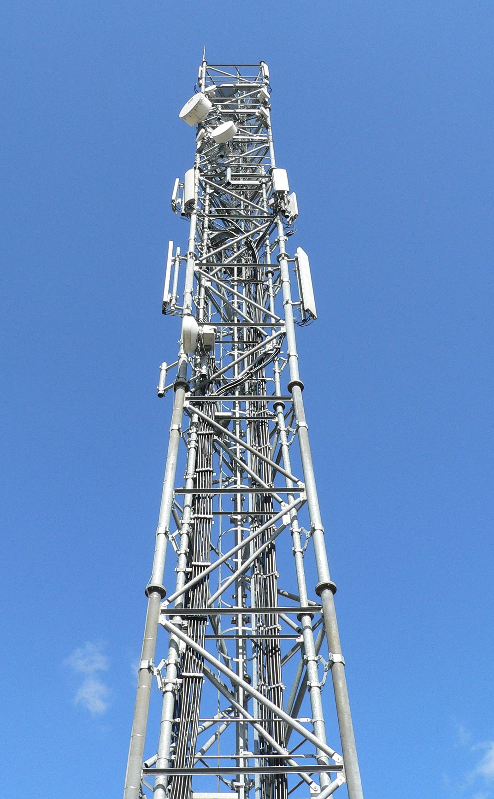
Business Introduction
Reder Telecom is a leading player in the telecommunications industry, providing a wide range of services including mobile, fixed-line, broadband, and television services to millions of customers across the country. With a strong presence in the market for over two decades, Reder Telecom has been known for its cutting-edge technology, reliable network, and exceptional customer service.
Their commitment to excellence extends across a spectrum of services, encompassing mobile, fixed-line, broadband, and television offerings. With a steadfast focus on fostering customer relationships, they have earned a sterling reputation for unparalleled reliability and exceptional customer service.

Slide 3
Business Problem
Reder Telecom is facing an increasing rate of customer churn, which is the percentage of customers who switch to competitors' services or terminate their subscriptions. The telecommunications industry is highly competitive, with multiple players offering similar services, and retaining existing customers is becoming increasingly difficult.
The specific obstacles the company faces include:
Intense competition from the many competitors in the market.
Changing customer Preferences usually because of their need for personalized and high-quality services.
Pricing pressures from competitors has affected profitability making competitive pricing very difficult to sustain.
Network quality and performance issues that influence customer satisfaction, which leads to dissatisfaction and churning.
Difficulty in building and maintaining customer loyalty.

Slide 4

Why Churn Prediction?
Churn prediction is a strategy that uses customer data to identify clients who are least likely to renew their contracts. The significance of initiating this project lies in its potential to address the aforementioned challenges and enhance Reder Telecom's operations. Here are the top reasons that underline the importance of this project:
Cost Reduction: Acquiring new customers is more expensive than retaining existing ones. Reducing churn can lead to substantial cost savings.
Revenue Growth: A reduction in churn can result in increased revenue as existing customers stay longer and potentially buy additional services.
Customer Satisfaction: Understanding customer behavior and preferences enables Reder Telecom to improve its services, leading to higher customer satisfaction and loyalty.
Competitive Advantage: By leveraging data analytics to predict churn, Reder Telecom can proactively retain customers and gain a competitive advantage over rivals.
Data-Driven Decision-Making: In an industry where data is abundant, using analytics to drive decisions can lead to more informed and effective strategies.

Slide 5
Project Objectives
The objectives of this project are as follows:
Develop a predictive model to identify customers at risk of churning.
Analyze the key factors contributing to customer churn.

Slide 6
Data Description
The dataset available from the company contains the following information:
Customer ID: A unique identifier for each customer.
Name: The name of the customer.
Age: The age of the customer.
Gender: The gender of the customer.
Location: The location or city where the customer is based.
Email: The email address of the customer.
Phone: The phone number of the customer.
Address: The postal address of the customer.
Segment: The customer segment or category to which the customer belongs (e.g., Segment A, Segment B, Segment C).

Slide 7
Data Description
The dataset available from the company contains the following information:
Purchase History: A list of dictionaries representing the customer's purchase history. Each dictionary includes details about products purchased, purchase frequency, and purchase value.
Product: Product name.
Frequency: The number of times this product was purchased by the customer.
Value: Cost of this product.
Subscription Details: A dictionary containing information about the customer's subscription plan, including the plan name, start date, and end date.
Plan: Name of the subscription plan.
Start Date: Start date of subscription plan.
End Date: End date of subscription plan.

Slide 8
Data Description
The dataset available from the company contains the following information:
Service Interactions: A list of dictionaries representing the customer's interactions with customer service. Each dictionary includes the type of interaction (e.g., Call, Email, Chat) and the date of the interaction.
Type: Type of service, it could be Call, Email or Chat.
Date: Date of the service interaction.
Payment History: A list of dictionaries representing the customer's payment history. Each dictionary includes the payment method (e.g., Credit Card, PayPal) and the number of late payments.
Method: Payment method, can either be Credit Card, PayPal or Bank Transfer.
Late Payments: Number of late payments.

Slide 9
Data Description
The dataset available from the company contains the following information:
Website Usage: A dictionary containing metrics related to the customer's usage of a website or app, including the number of page views and time spent (in minutes).
Page Views: The number of website page views from the customer.
Time Spent: Time spent on the website by a customer in minutes.
Clickstream Data: A list of dictionaries representing the customer's clickstream data, including actions such as clicks, searches, and adding items to the cart. Each dictionary includes the action type, the page where the action occurred, and a timestamp.
Action: Clickstream action of the user, could be Click, Search or Add to Cart.
Page: The website page in which the user performed this action.
Timestamp: Timestamp of the clickstream action.

Slide 10
Data Description
The dataset available from the company contains the following information:
Engagement Metrics: A dictionary containing engagement metrics, such as the number of logins and the frequency of engagement (e.g., Daily, Weekly, Monthly).
Logins: The number of logins the user made.
Frequency: How often a customer logs in to the platform. Could be Daily, Weekly or Monthly.
Feedback: Feedback provided by the customer, including a rating (e.g., 1 to 5) and a comment.
Rating: A value between 1 and 5 that indicates the customer’s feedback rating.
Comment: The comment left by the customer for the feedback.

Slide 11
Data Description
The dataset available from the company contains the following information:
Marketing Communication: A list of dictionaries representing the customer's history of marketing communication, including dates when emails were sent, opened, and clicked.
Email Sent: Date when email was sent.
Email Opened: Date when email was opened.
Email Clicked: Date when email was clicked.
NPS: The Net Promoter Score (NPS) of the customer, which measures customer loyalty and satisfaction on a scale of 0 to 10.
Churn Label: A binary label indicating whether the customer has churned (1 for churn, 0 for no churn).
Timestamp: The timestamp indicating when the data was recorded for the customer.

Slide 12


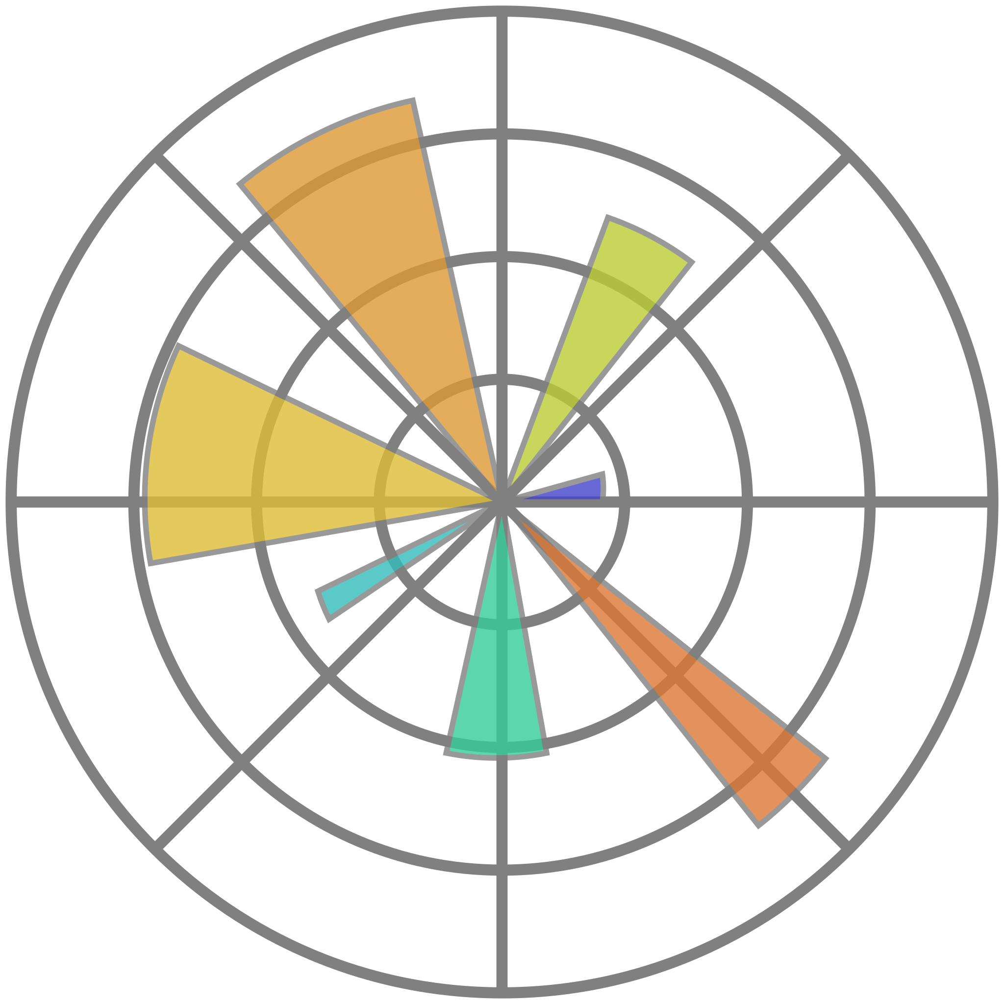


Tech Stack
Pandas
NumPy
Matplotlib
Seaborn
Sklearn

Slide 13
Data Science Project Scope
Data Collection
Data Exploration
Data Preprocessing
Gather historical customer data from various sources
Explore the dataset to understand the structure, statistics and get insights.
Scale variables, encode features.
Evaluation
Model Development
Feature Engineering
Evaluate the model on different metrics like accuracy, precision, etc.
Build ML models to predict churn from the dataset.
Create new features, segment dataset, remove irrelevant features.

